Slide 1



विकसित भारत @2047
Empowered Indians
-Nishtha Rawat
Biotechnology II year

Slide 2
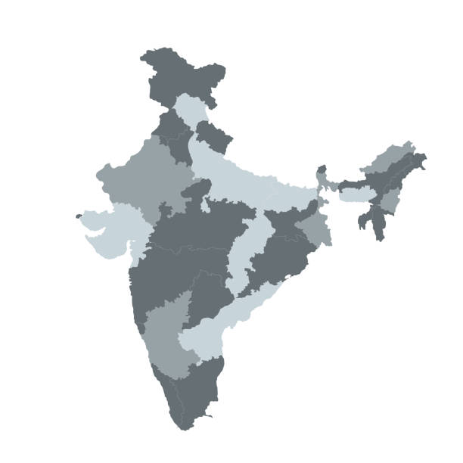
Bharat @ 2047
poverty reduction
development of human values
Human development
Addressing social and economic inequalities
saturated schemes
Promoting innovation and entrepreneurship
rural empowerment

Slide 3





NEED FOR EMPOWERMENT
1.
Unlocking
potential
2.
Intercultural
collaboration
3.
Economic
Impact

Slide 4

National Institution for Transforming India
(NITI Aayog)
Ministry of Women and Child Development
Ministry of Minority Affairs
Ministry of Tribal Affairs
Government agencies working towards the empowerment of Indians
Ministry of Skill Development and Entrepreneur-ship
Ministry of Human Resource Development (now Ministry of Education)
Ministry of Social Justice and Empowerment
Ministry of health and family welfare

Slide 5

YOUTH EMPOWERMENT
The role of youth in contributing to the development of India is crucial, as they represent the future of the nation.
Building skill based workforce
Promoting social inclusivity
Investing in youth empowers them with the necessary skills for economic growth
Youth empowerment ensures equal opportunities and representation for all
Youth as agents of change
Empowered youth can drive innovation and bring about positive social transformation

Slide 6

SWOT analysis
Strength:
India's youth population presents a dynamic and diverse talent pool for innovation and growth.
Weakness:
Challenges such as unemployment and skill gaps hinder the full potential of the youth demographic.
1.
2.
Opportunity:
Leveraging technology and entrepreneurship can unlock the potential of India's youth for sustainable development.
Threat:
Social and economic disparities may impede the holistic empowerment of the youth.
3.
4.

Slide 7
1. Education and Skill Development:
Pursue continuous learning, participate in vocational training, and acquire skills aligned with emerging industries.
Role: Actively engage in education and skill development programs to acquire the knowledge and skills needed for personal growth and contribution to society.
Digital Mentorship Platforms
Skill Development Hubs (Rural and Urban areas)

Slide 8
2.Civic Engagement and Social Responsibility:
Role: Act as responsible citizens by actively participating in civic activities and contributing to social causes.
Volunteer for community service, engage in environmental initiatives, and advocate for social justice.
Youth-Led Community Projects Fund
Interactive Civic Education Programs

Slide 9

Success stories
young people bringing change to their countries
Emma Gonzalez and Parkland Survivors (United States)
Malala Yousafzai
Greta Thunberg (Sweden)
Joshua Wong (Hong Kong)
Juan Guaidó (Venezuela)
Alexandria Ocasio-Cortez (United States)
Kailash Satyarthi (India)

Slide 10

THANK YOU
Join the Voice of Youth Empowered Indians

